Slide 1
Team JUA
Jeremy Xia, Ava Fu, Yu Li

Slide 2
Contents
Introducing: Mega Press
Understanding the problems
Project Features
Use Cases
Demo
Future RoadMap

Slide 3
Mega Press
Time
Design
AI
saver
swift
powered

Slide 4
Understanding the problems
01
NewsLetter Template Creation Steps: Design Picture, Convert to HTML. Every Steps involves a lot manual work and negotiation.
02
News writer requires different writing styles for similar content. Like people strategy, employee spotlight.
03
Content fill manually cost extra time. New releases template and content adjustment.

Slide 5
Project Features
Auto Suggesting
Template Design

Slide 6



Use Cases
Design, Preview, Release in one place
Fast Prototype
Web Team get html template directly

Slide 7
Boost
Mega Press
Just everything faster
75%
83%
42%
35%
Auto Suggesting
Design Template
Auto Complete
Template Auto Filling

Slide 8
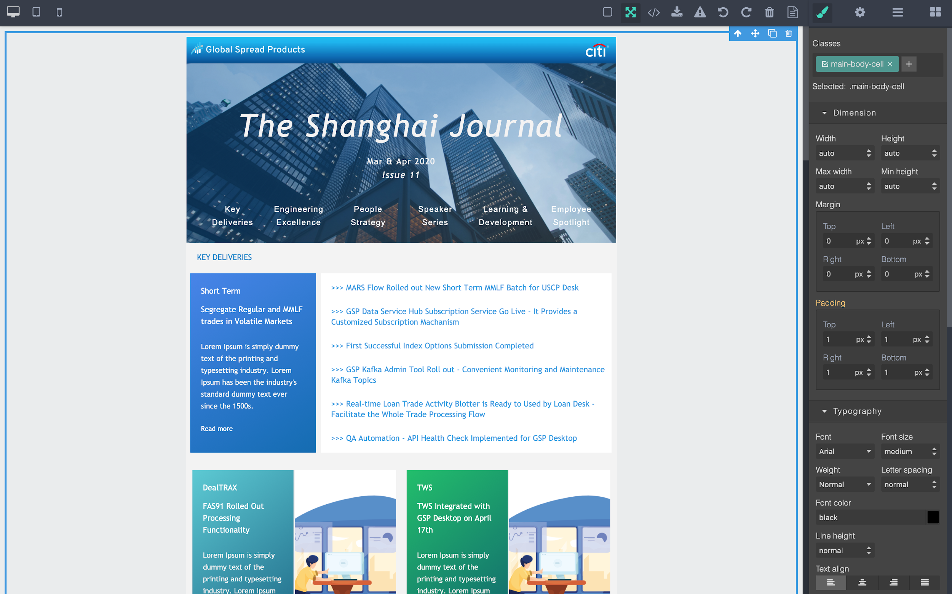
Demo Time

Slide 9
Future Road Map
04
Integration
People
Integrate with newsletter platform
Involves with Innovation Team to set up Citi news release platform
01
03
Share
Localization
Designer library for templates
Train Citi news model for auto suggesting
02

Slide 10
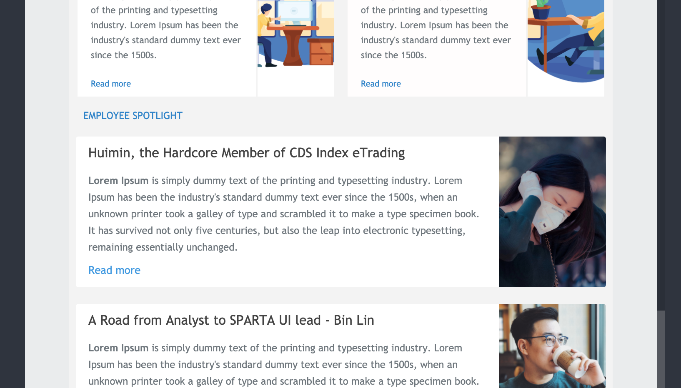
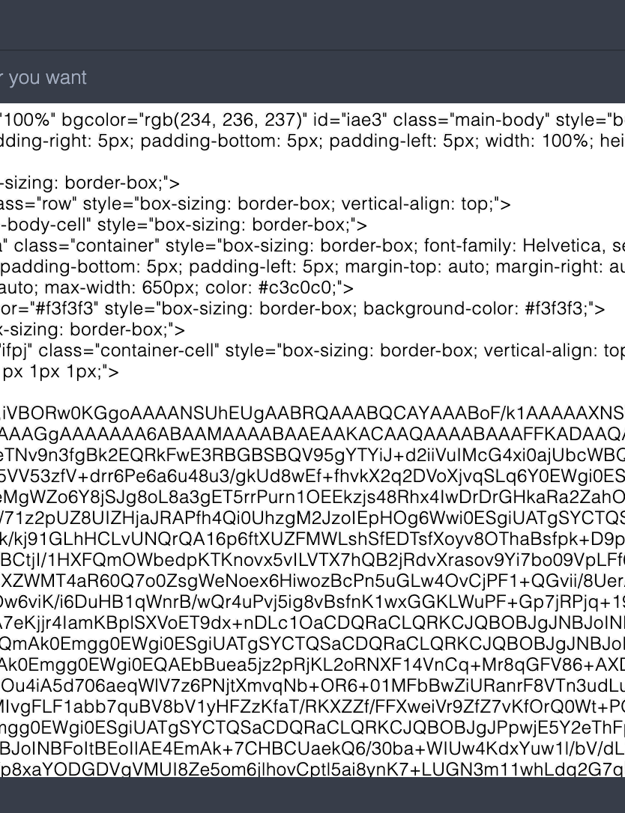
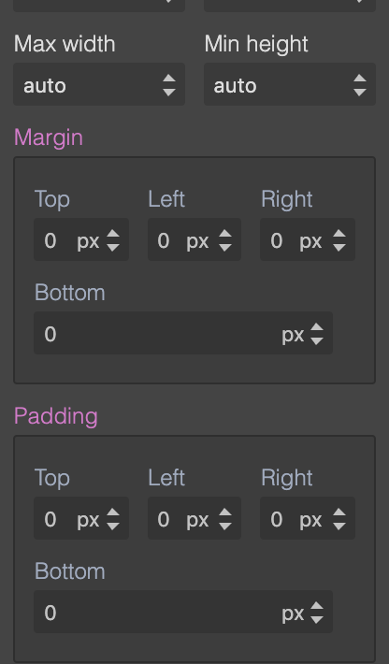
Thank you!
References:
grapes.js<https://github.com/artf/grapesjs>
ckeditor<https://github.com/ckeditor/>
transformers<https://github.com/huggingface/transformers>

